Slide 1
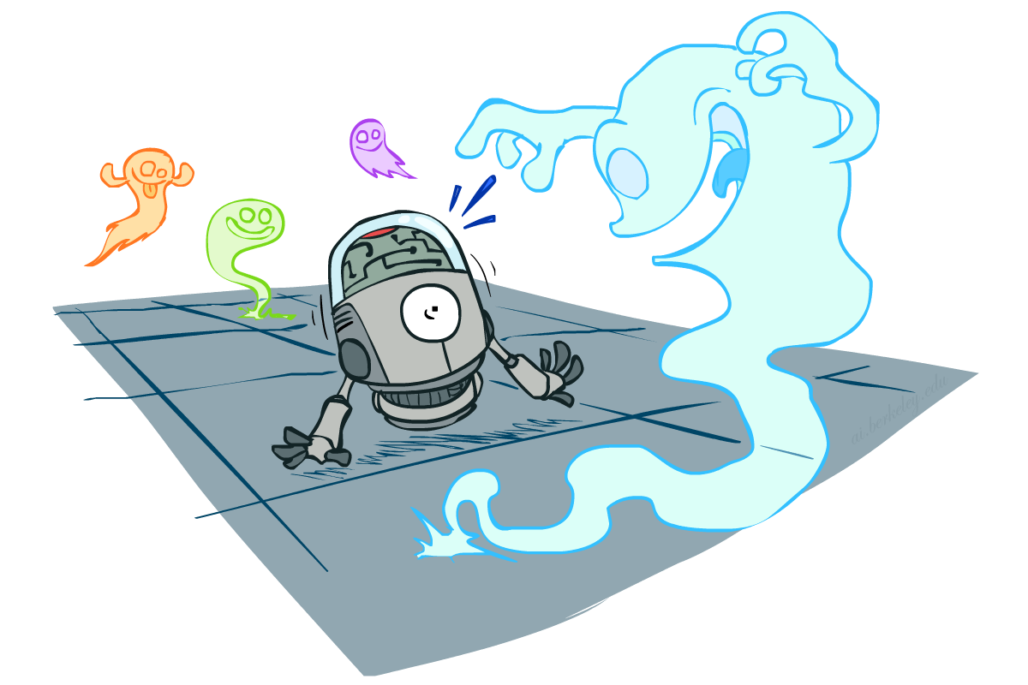
CS 188: Artificial Intelligence
Probability
Instructors: Stuart Russell and Peyrin Kao
University of California, Berkeley
Notes:
Please retain proper attribution, including the reference to ai.berkeley.edu. Thanks!

Slide 2
Uncertainty
The real world is rife with uncertainty!
E.g., if I leave for SFO 60 minutes before my flight, will I be there in time?
Problems:
partial observability (road state, other drivers’ plans, etc.)
noisy sensors (radio traffic reports, Google maps)
immense complexity of modelling and predicting traffic, security line, etc.
lack of knowledge of world dynamics (will tire burst? need COVID test?)
Probabilistic assertions summarize effects of ignorance and laziness
Combine probability theory + utility theory -> decision theory
Maximize expected utility : a* = argmax_{a} ∑_{s} P(s | a) U(s)

Slide 3
Basic laws of probability (discrete)
Begin with a set Ω of possible worlds
E.g., 6 possible rolls of a die, {1, 2, 3, 4, 5, 6}
A probability model assigns a number P(ω) to each world ω
E.g., P(1) = P(2) = P(3) = P(5) = P(5) = P(6) = 1/6.
These numbers must satisfy
0 ≤ P(ω) ≤ 1
∑_{ω ∈Ω} P(ω) = 1

Slide 4
Basic laws contd.
An event is any subset of Ω
E.g., “roll < 4” is the set {1,2,3}
E.g., “roll is odd” is the set {1,3,5}
The probability of an event is the sum of probabilities over its worlds
P(A) = ∑_{ω ∈ A} P(ω)
E.g., P(roll < 4) = P(1) + P(2) + P(3) = 1/2
De Finetti (1931): anyone who bets according to probabilities that violate these laws can be forced to lose money on every set of bets

Slide 5

Random Variables
A random variable (usually denoted by a capital letter) is some aspect of the world about which we may be uncertain
Formally a deterministic function of ω
The range of a random variable is the set of possible values
Odd = Is the dice roll an odd number? → {true, false}
e.g. Odd(1)=true, Odd(6) = false
often write the event Odd=true as odd, Odd=false as ¬odd
T = Is it hot or cold? → {hot, cold}
D = How long will it take to get to the airport? → [0, ∞)
L_{Ghost} = Where is the ghost? → {(0,0), (0,1), …}
The probability distribution of a random variable X gives the probability for each value x in its range (probability of the event X=x)
P(X=x) = ∑ _{{ω: X(ω)=x}} P(ω)
P(x) for short (when unambiguous)
P(X) refers to the entire distribution (think of it as a vector or table)

Slide 6
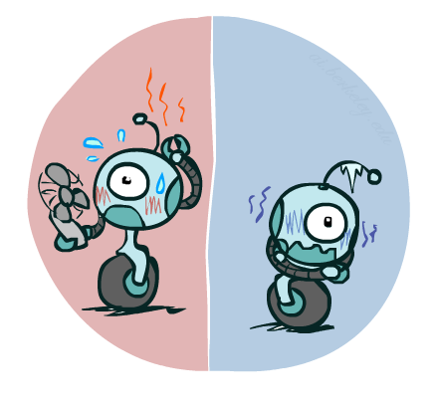
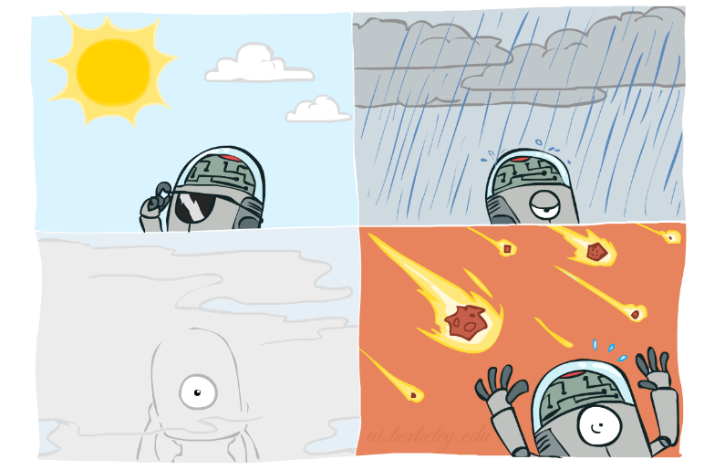
Probability Distributions
Associate a probability with each value; sums to 1
Temperature:
Weather:
Joint distribution
P(W)
P(T,W)
P(T)
W | P
sun | 0.6
rain | 0.1
fog | 0.3
meteor | 0.0
T | P
hot | 0.5
cold | 0.5
 |  | Temperature
 |  | hot | cold
Weather | sun | 0.45 | 0.15
 | rain | 0.02 | 0.08
 | fog | 0.03 | 0.27
 | meteor | 0.00 | 0.00

Slide 7
Making possible worlds
In many cases we
begin with random variables and their domains
construct possible worlds as assignments of values to all variables
E.g., two dice rolls Roll₁ and Roll₂
How many possible worlds?
What are their probabilities?
Size of distribution for n variables with range size d?
For all but the smallest distributions, cannot write out by hand!
d^{n}

Slide 8
Probabilities of events
Recall that the probability of an event is the sum of probabilities of its worlds:
P(A) = ∑_{ω ∈ A} P(ω)
So, given a joint distribution over all variables, can compute any event probability!
Probability that it’s hot AND sunny?
Probability that it’s hot?
Probability that it’s hot OR not foggy?
Joint distribution
P(T,W)
 |  | Temperature
 |  | hot | cold
Weather | sun | 0.45 | 0.15
 | rain | 0.02 | 0.08
 | fog | 0.03 | 0.27
 | meteor | 0.00 | 0.00

Slide 9
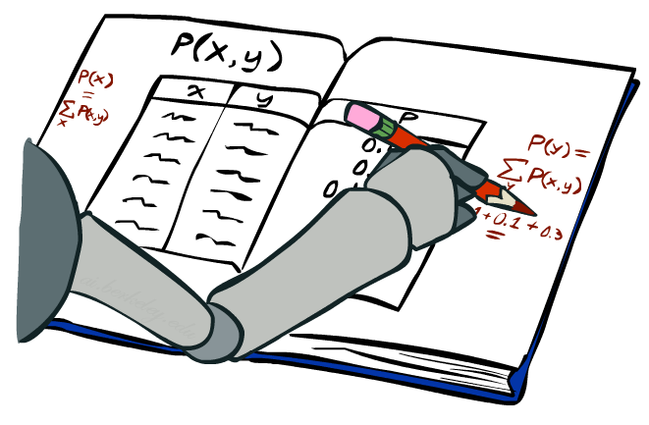
Marginal Distributions
Marginal distributions are sub-tables which eliminate variables
Marginalization (summing out): Collapse a dimension by adding
P(X=x) = ∑_{y} P(X=x, Y=y)
 |  | Temperature
 |  | hot | cold
Weather | sun | 0.45 | 0.15
 | rain | 0.02 | 0.08
 | fog | 0.03 | 0.27
 | meteor | 0.00 | 0.00
0.60
0.10
0.30
0.00
P(W)
0.50 | 0.50
P(T)

Slide 10
Conditional Probabilities
A simple relation between joint and conditional probabilities
In fact, this is taken as the definition of a conditional probability
P(a,b)
P(a, b)
P(b)
P(a | b) =
P(T,W)
P(a)
P(b)
 |  | Temperature
 |  | hot | cold
Weather | sun | 0.45 | 0.15
 | rain | 0.02 | 0.08
 | fog | 0.03 | 0.27
 | meteor | 0.00 | 0.00
P(W=s,T=c)
P(T=c)
P(W=s | T=c) =
= 0.15/0.50 = 0.3
= P(W=s,T=c) + P(W=r,T=c) + P(W=f,T=c) + P(W=m,T=c)
= 0.15 + 0.08 + 0.27 + 0.00= 0.50

Slide 11
Conditional Distributions
Distributions for one set of variables given another set
P(W | T=h)
P(W | T=c)
P(W | T)
 |  | Temperature
 |  | hot | cold
Weather | sun | 0.45 | 0.15
 | rain | 0.02 | 0.08
 | fog | 0.03 | 0.27
 | meteor | 0.00 | 0.00
hot
cold
hot
cold
0.90
0.04
0.06
0.00
0.30
0.16
0.54
0.00
0.90
0.04
0.06
0.00
0.30
0.16
0.54
0.00

Slide 12
Normalizing a distribution
(Dictionary) To bring or restore to a normal condition
Procedure:
Multiply each entry by α = 1/(sum over all entries)
All entries sum to ONE
P(W,T)
P(W | T=c) = P(W,T=c)/P(T=c)
= α P(W,T=c)
 |  | Temperature
 |  | hot | cold
Weather | sun | 0.45 | 0.15
 | rain | 0.02 | 0.08
 | fog | 0.03 | 0.27
 | meteor | 0.00 | 0.00
P(W,T=c)
0.15
0.08
0.27
0.00
0.30
0.16
0.54
0.00
Normalize
α = 1/0.50 = 2

Slide 13
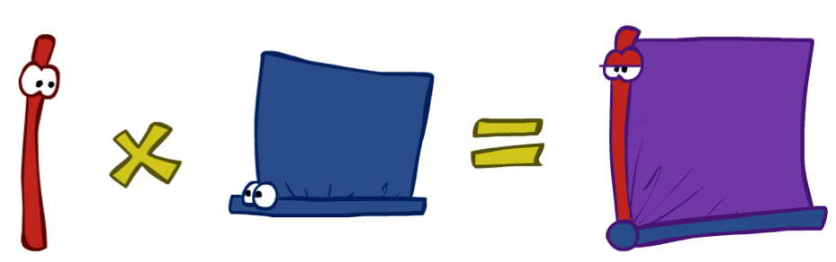
The Product Rule
Sometimes have conditional distributions but want the joint
P(a | b) P(b) = P(a, b)
P(a, b)
P(b)
P(a | b) =

Slide 14
The Product Rule: Example
P(W | T) P(T) = P(W, T)
P(W | T)
P(W, T)
hot
cold
 |  | Temperature
 |  | hot | cold
Weather | sun | 0.45 | 0.15
 | rain | 0.02 | 0.08
 | fog | 0.03 | 0.27
 | meteor | 0.00 | 0.00
P(T)
0.90
0.04
0.06
0.00
0.30
0.16
0.54
0.00
T | P
hot | 0.5
cold | 0.5

Slide 15
The Chain Rule
A joint distribution can be written as a product of conditional distributions by repeated application of the product rule:
P(x₁, x₂, x₃) = P(x₃ | x₁, x₂) P(x₁, x₂) = P(x₃ | x₁, x₂) P(x₂ | x₁) P(x₁)
P(x₁, x₂,…, x_{n}) = ∏_{i} P(x_{i} | x₁,…, x_{i-1})

Slide 16

Probabilistic Inference
Probabilistic inference: compute a desired probability from a probability model
Typically for a query variable given evidence
E.g., P(airport on time | no accidents) = 0.90
These represent the agent’s beliefs given the evidence
Probabilities change with new evidence:
P(airport on time | no accidents, 5 a.m.) = 0.95
P(airport on time | no accidents, 5 a.m., raining) = 0.80
Observing new evidence causes beliefs to be updated

Slide 17
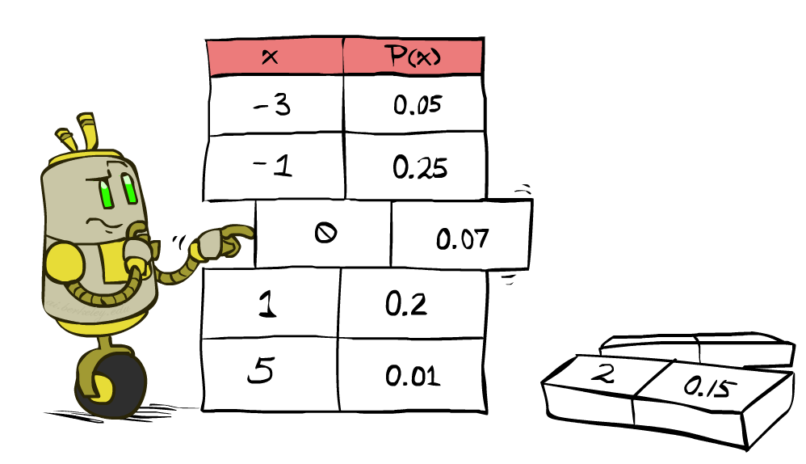
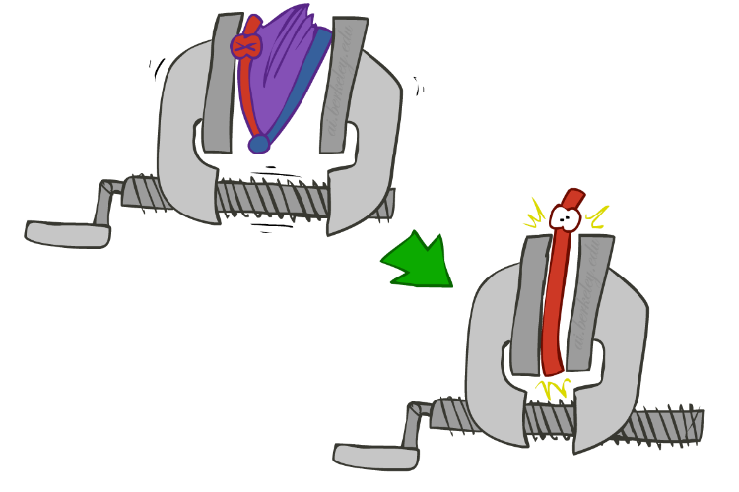
Inference by Enumeration
We want:
P(Q | e)
Probability model P(X₁, …, X_{n}) is given
Partition the variables X₁, …, X_{n} into sets as follows:
Evidence variables: E = e
Query variables: Q
Hidden variables: H
Step 1: Select the entries consistent with the evidence
Step 2: Sum out H from model to get joint of query and evidence
Step 3: Normalize
P(Q ,e) =
∑_{h} P(Q , h, e)
P(Q | e) = α P(Q ,e)
X₁, …, X_{n}

Slide 18
Inference by Enumeration
Season | Temp | Weather | P
summer | hot | sun | 0.35
summer | hot | rain | 0.01
summer | hot | fog | 0.01
summer | hot | meteor | 0.00
summer | cold | sun | 0.10
summer | cold | rain | 0.05
summer | cold | fog | 0.09
summer | cold | meteor | 0.00
winter | hot | sun | 0.10
winter | hot | rain | 0.01
winter | hot | fog | 0.02
winter | hot | meteor | 0.00
winter | cold | sun | 0.15
winter | cold | rain | 0.20
winter | cold | fog | 0.18
winter | cold | meteor | 0.00
P(W)?

Slide 19
Inference by Enumeration
Season | Temp | Weather | P
summer | hot | sun | 0.35
summer | hot | rain | 0.01
summer | hot | fog | 0.01
summer | hot | meteor | 0.00
summer | cold | sun | 0.10
summer | cold | rain | 0.05
summer | cold | fog | 0.09
summer | cold | meteor | 0.00
winter | hot | sun | 0.10
winter | hot | rain | 0.01
winter | hot | fog | 0.02
winter | hot | meteor | 0.00
winter | cold | sun | 0.15
winter | cold | rain | 0.20
winter | cold | fog | 0.18
winter | cold | meteor | 0.00
P(W)?
P(W | winter)?

Slide 20
Inference by Enumeration
Obvious problems:
Worst-case time complexity O(d^{n}) (exponential in #hidden variables)
Space complexity O(d^{n}) to store the joint distribution
O(d^{n}) data points to estimate the entries in the joint distribution

Slide 21
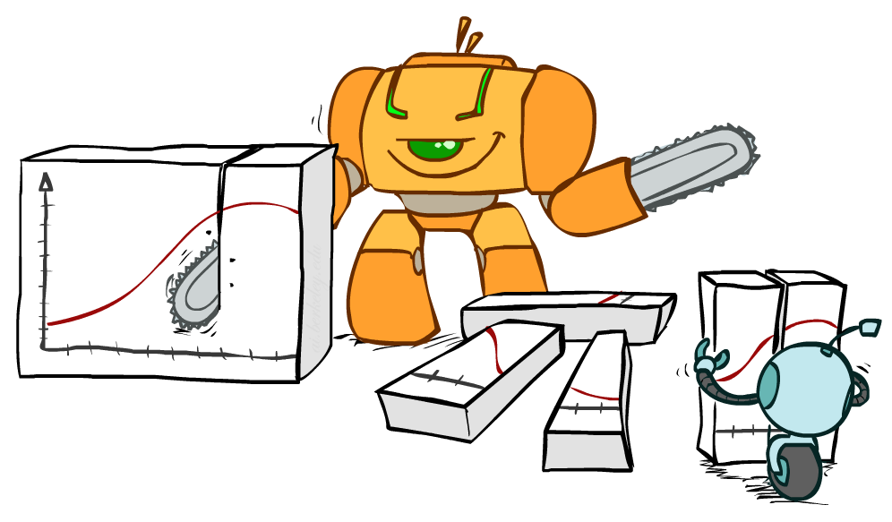
Bayes Rule

Slide 22
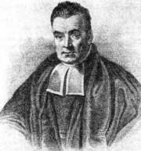
Bayes’ Rule
Write the product rule both ways:
P(a | b) P(b) = P(a, b) = P(b | a) P(a)
Dividing left and right expressions, we get:
Why is this at all helpful?
Lets us build one conditional from its reverse
Often one conditional is tricky but the other one is simple
Describes an “update” step from prior P(a) to posterior P(a | b)
Hence provides a simple, formal theory of learning
That’s my rule!
P(b | a) P(a)
P(b)
P(a | b) =

Slide 23
Inference with Bayes’ Rule
Example: Diagnostic probability from causal probability:
Example:
M: meningitis, S: stiff neck
Note: posterior probability of meningitis still very small: 0.008 (80x bigger – why?)
Note: you should still get stiff necks checked out! Why?
P(effect | cause) P(cause)
P(effect)
P(cause | effect) =
P(s | m) = 0.8
P(m) = 0.0001
P(s) = 0.01
Example
givens
P(s | m) P(m)
P(s)
0.8 x 0.0001 .
0.01
P(m | s) =
=

Slide 24

Independence
Two variables X and Y are (absolutely) independent if
∀x,y P(x, y) = P(x) P(y)
I.e., the joint distribution factors into a product of two simpler distributions
Equivalently, via the product rule P(x,y) = P(x|y)P(y),
P(x | y) = P(x) or P(y | x) = P(y)
Example: two dice rolls Roll₁ and Roll₂
P(Roll₁=5, Roll₂=3) = P(Roll₁=5) P(Roll₂=3) = 1/6 x 1/6 = 1/36
P(Roll₂=3 | Roll₁=5) = P(Roll₂=3)

Slide 25


Example: Independence
n fair, independent coin flips:
P(X₁)
P(X₂)
P(X_{n})
H | 0.5
T | 0.5
H | 0.5
T | 0.5
H | 0.5
T | 0.5
P(X₁,X₂,...,X_{n})
2^{n}

Slide 26
Independence, contd.
Independence is incredibly powerful
Exponential reduction in representation size
Independence is extremely rare!
Conditional independence is ubiquitous!!

Slide 27
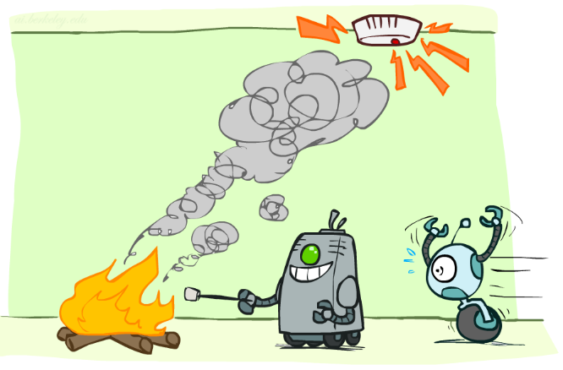
Conditional Independence

Slide 28
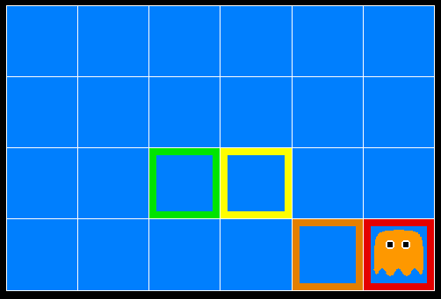
Ghostbusters
A ghost is in the grid somewhere
Sensor readings tell how close a square is to the ghost
On the ghost: usually red
1 or 2 away: mostly orange
3 or 4 away: typically yellow
5+ away: often green
Click on squares until confident of location, then “bust”

Slide 29

Video of Demo Ghostbusters with Probability

Slide 30
Ghostbusters model
0.11
0.11
0.11
Variables and ranges:
G (ghost location) in {(1,1),…,(3,3)}
C_{x,y} (color measured at square x,y) in {red,orange,yellow,green}
Ghostbuster physics:
Uniform prior distribution over ghost location: P(G)
Sensor model: P(C_{x,y} | G) (depends only on distance to G)
E.g. P(C_{1,1} = yellow | G = (1,1) ) = 0.1
0.11
0.11
0.11
0.11
0.11
0.11

Slide 31

Ghostbusters model, contd.
0.11
0.11
0.11
P(G, C_{1,1} , … C_{3,3}) has 9 x 4⁹ = 2,359,296 entries!!!
Ghostbuster independence:
Are C_{1,1} and C_{1,2} independent?
E.g., does P(C_{1,1} = yellow) = P(C_{1,1} = yellow | C_{1,2} = orange) ?
Ghostbuster physics again:
P(C_{x,y} | G) depends only on distance to G
So P(C_{1,1} = yellow | G = (2,3) ) = P(C_{1,1} = yellow | G = (2,3), C_{1,2} = orange)
I.e., C_{1,1} is conditionally independent of C_{1,2} given G
0.11
0.11
0.11
0.11
0.11
0.11

Slide 32
Ghostbusters model, contd.
Apply the chain rule to decompose the joint probability model:
P(G, C_{1,1} , … C_{3,3}) = P(G) P(C_{1,1} | G) P(C_{1,2} | G, C_{1,1}) P(C_{1,3} | G, C_{1,1}, C_{1,2}) … P(C_{3,3} | G, C_{1,1}, …, C_{3,2})
Now simplify using conditional independence:
P(G, C_{1,1} , … C_{3,3}) = P(G) P(C_{1,1} | G) P(C_{1,2} | G) P(C_{1,3} | G) … P(C_{3,3} | G)
I.e., conditional independence properties of ghostbuster physics simplify the probability model from exponential to quadratic in the number of squares
This is called a Naïve Bayes model:
One discrete query variable (often called the class or category variable)
All other variables are (potentially) evidence variables
Evidence variables are all conditionally independent given the query variable
G
C_{1,1}
C_{1,2}
C_{3,3}

Slide 33
Conditional Independence
Conditional independence is our most basic and robust form of knowledge about uncertain environments.
X is conditionally independent of Y given Z if and only if:
∀x,y,z P(x | y, z) = P(x | z)
or, equivalently, if and only if
∀x,y,z P(x, y | z) = P(x | z) P(y | z)

Slide 34
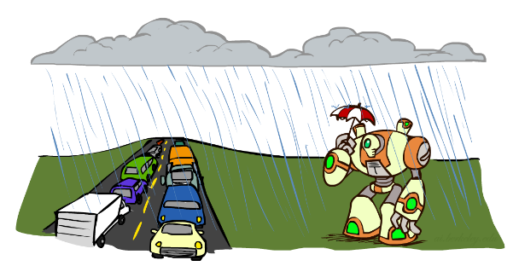
Conditional Independence
What about this domain:
Traffic
Umbrella
Raining

Slide 35

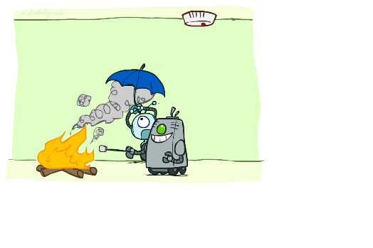
Conditional Independence
What about this domain:
Fire
Smoke
Alarm

Slide 36
Next time
Bayes nets
Elementary inference in Bayes nets

